Slide 1


(Problem Statement)
Data Science and AI ML
Team Members:
1.
2.
3.
4.
5.
6.
Guide:

Slide 2
Agenda:
Introduction
SMART Objectives
5W1H Analysis and SCAMPER Ideation
Literature Insights (Short)
Proposed Solution
System Overview (Basic Diagram)
Gantt Chart
Expected Outcome

Slide 3
Problem Statement
Crop diseases cause major losses in agriculture
Farmers often fail to detect diseases early
Manual inspection is slow and inaccurate
Lack of expert availability in rural areas
Need for an automated, fast, and accurate solution

Slide 4
Introduction
Problem Area
Plant disease detection in agriculture using image-based AI systems.
Who Faces This Problem?
Farmers
Agricultural workers
Crop inspectors
Where Does It Occur?
Farms and agricultural fields
Rural areas with limited expert access
Why Is It Important?
Prevents crop loss
Improves crop quality and yield
Helps farmers take early action

Slide 5
Objectives (SMART)
Objective 1: Specific Develop a system to detect plant diseases from leaf images.
Objective 2: Measurable Achieve high accuracy (around 90%) in disease detection.
Objective 3: Achievable Use CNN models like MobileNet/ResNet for implementation.
Objective 4: Relevant Helps farmers improve crop health and reduce losses.
Objective 5: Time Bound Complete the project within the given timeline.

Slide 6
5W1H Analysis
Question | Answer
Who | Farmers, agricultural experts
What | Detect plant diseases using images
Where | Farms, agricultural fields
When | During crop growth stages
Why | To reduce crop loss and increase yield
How | Using AI + CNN models

Slide 7
SCAMPER Ideation (Optional)
Substitute → chatbot instead of humans
Combine → NLP + APIs
Adapt
Modify → better intent detection
Put to Another Use
Eliminate
Reverse → proactive chatbot

Slide 8
Literature Insights
Search Keywords Used
Plant disease detection using AI
CNN for leaf disease classification
Deep learning in agriculture
Image processing for crop disease
Papers Selected
Research on CNN-based plant disease detection
Studies using deep learning for agriculture
Papers on image classification using leaf datasets
Gaps Identified
Many systems lack real-time detection
Limited mobile/offline support
Some models have lower accuracy
Lack of user-friendly applications for farmers

Slide 9
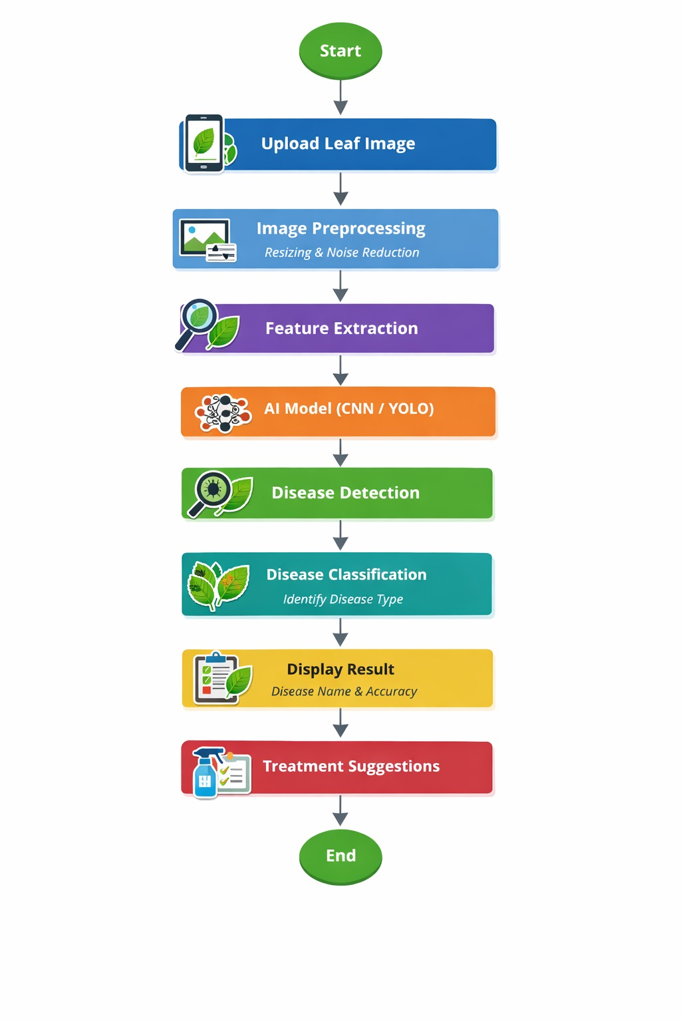
Proposed Solution
Design Phase

Slide 10
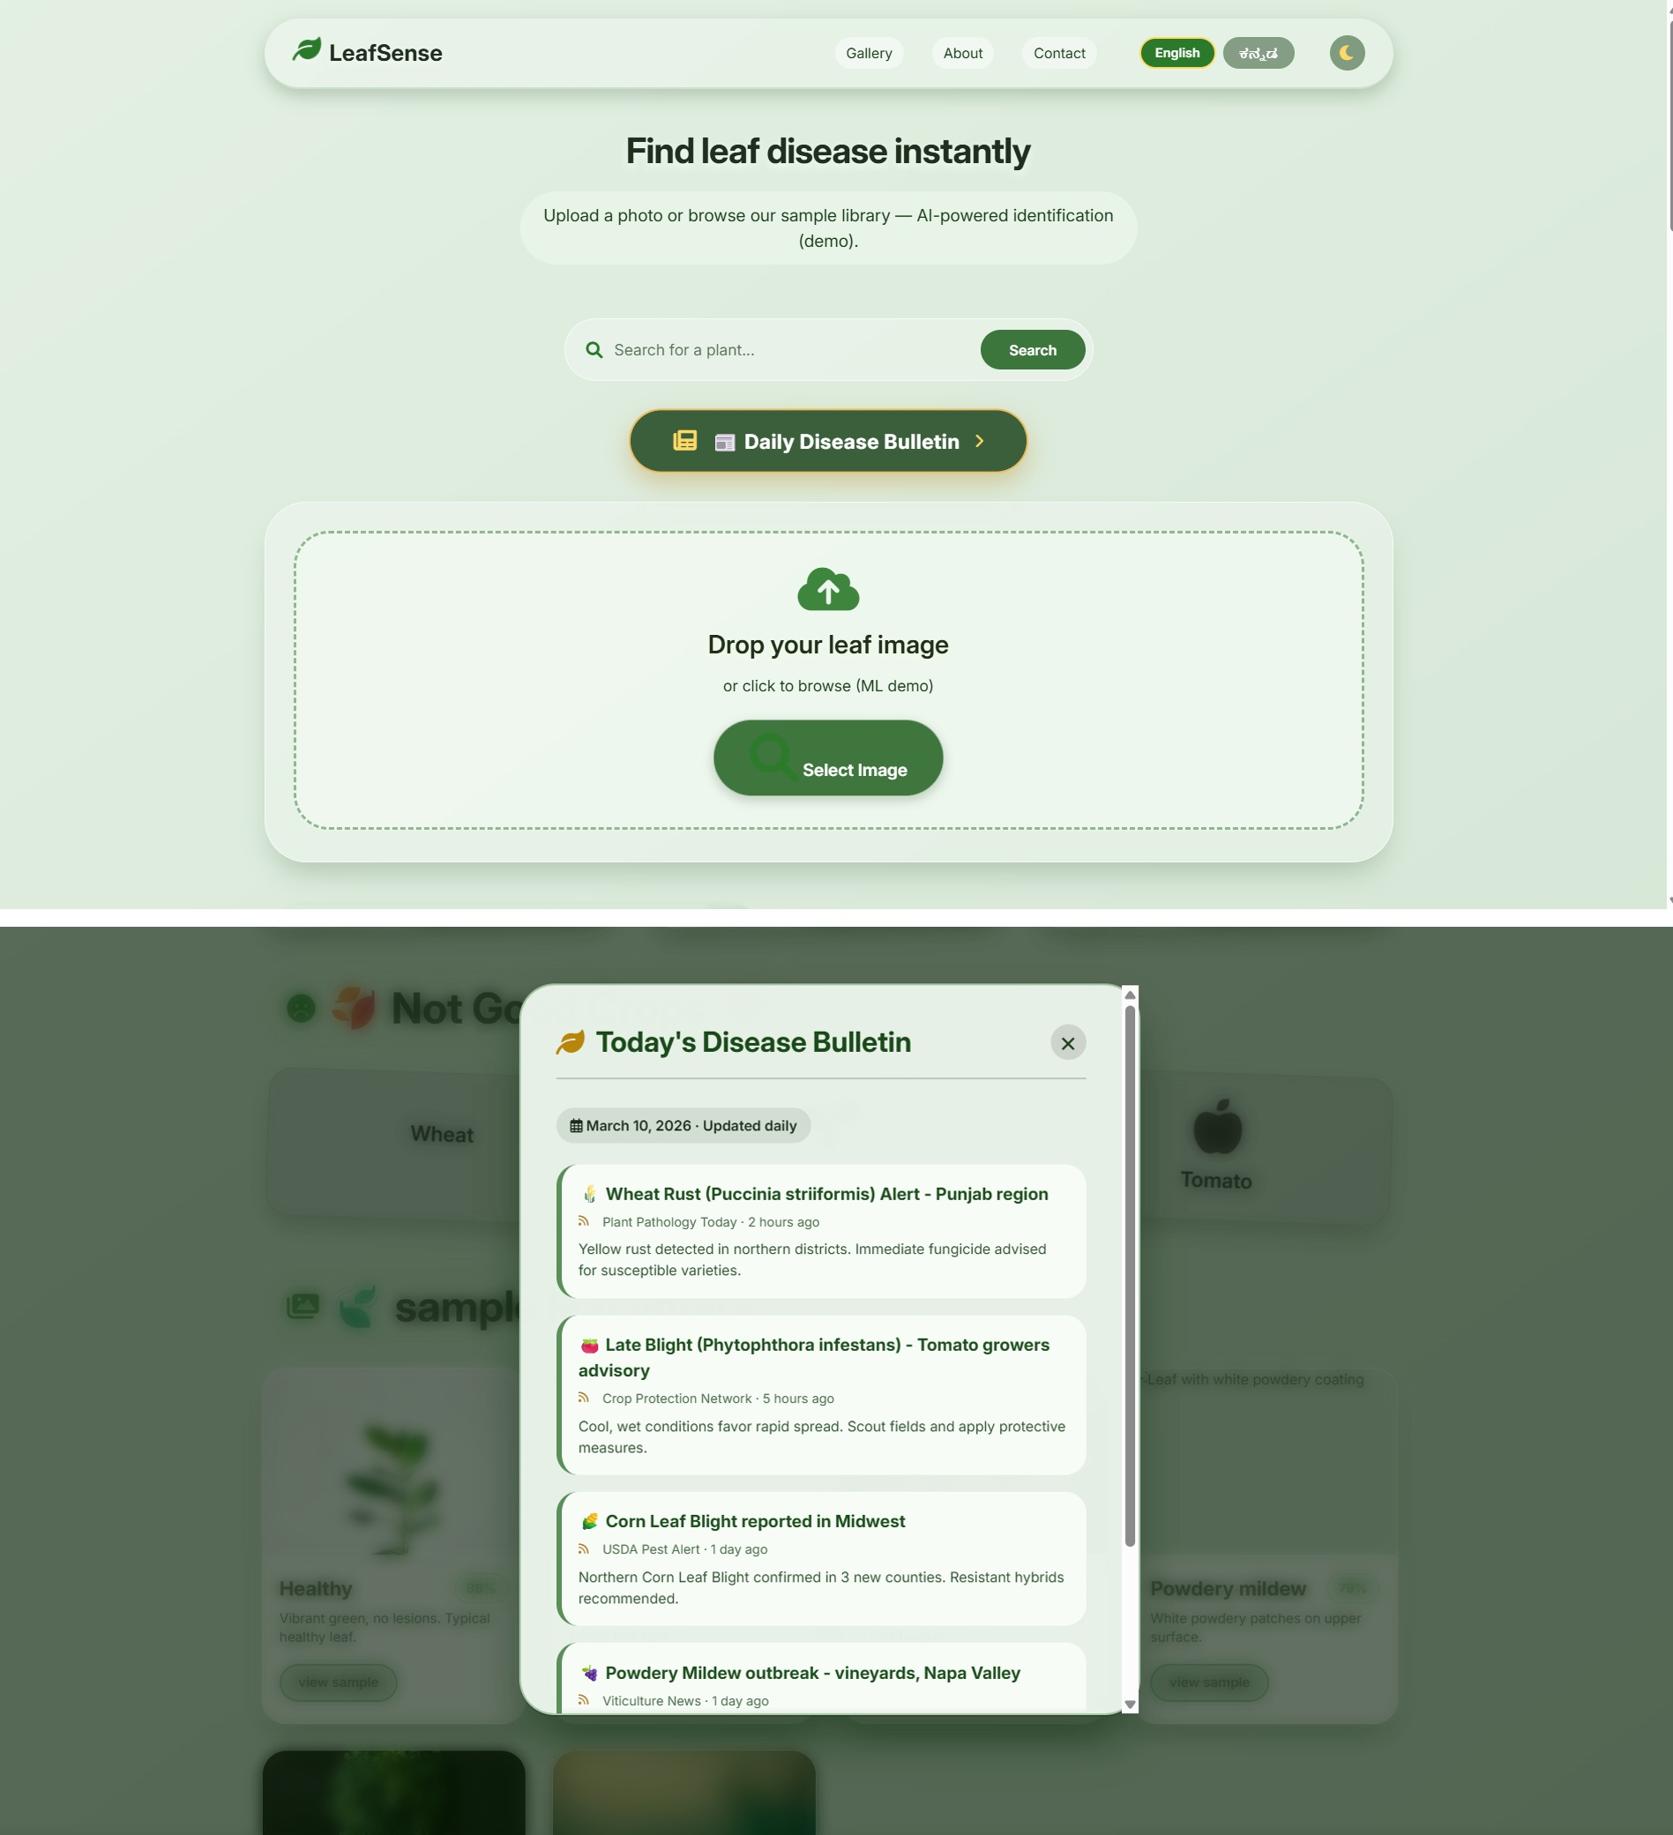

Slide 11
Installation & System Overview (Basic Diagram)Configuration
Installation
Install Python and required libraries
Install TensorFlow / Keras
Install OpenCV
Install Flask for backend (optional)
Load trained CNN model
System Overview (Basic Diagram)
Flow:
User → Image Upload → Preprocessing → CNN Model → Prediction → Result Display
Configuration
Input: Leaf image (camera/upload)
Model: CNN (MobileNet/ResNet)
Output: Disease name + confidence
Platform: Web / Mobile application

Slide 12
Gantt Chart
Project Details | Week 1 | Week 2 | Week 3 | Week 4 | Week 5 | Week 6 | Week 7 | Week 8 | Week 9 | Week 10 | Week 11 | Week 12 | Week 13 | Week 14 | Week 15 | Week 16
 |  | ■ | ■
 |  |  | ■ | ■
 |  |  | ■ | ■ | ■
 |  |  |  | ■ | ■
 |  |  |  |  | ■ | ■ | ■
 |  |  |  |  |  |  |  | ■ | ■ | ■ | ■
 |  |  |  |  |  |  |  |  |  | ■ | ■ | ■
 |  |  |  |  |  |  |  |  |  |  | ■ | ■ | ■
 |  |  |  |  |  |  |  |  |  |  |  | ■ | ■ | ■
 |  |  |  |  |  |  |  |  |  |  |  |  |  | ■ | ■
 |  |  |  |  |  |  |  |  |  |  |  |  |  |  |  | ■

Slide 13
Expected Outcome
Accurate detection of plant diseases
Faster results compared to manual methods
Early identification helps reduce crop loss
Easy-to-use system for farmers
Improved crop quality and productivity

